Slide 1
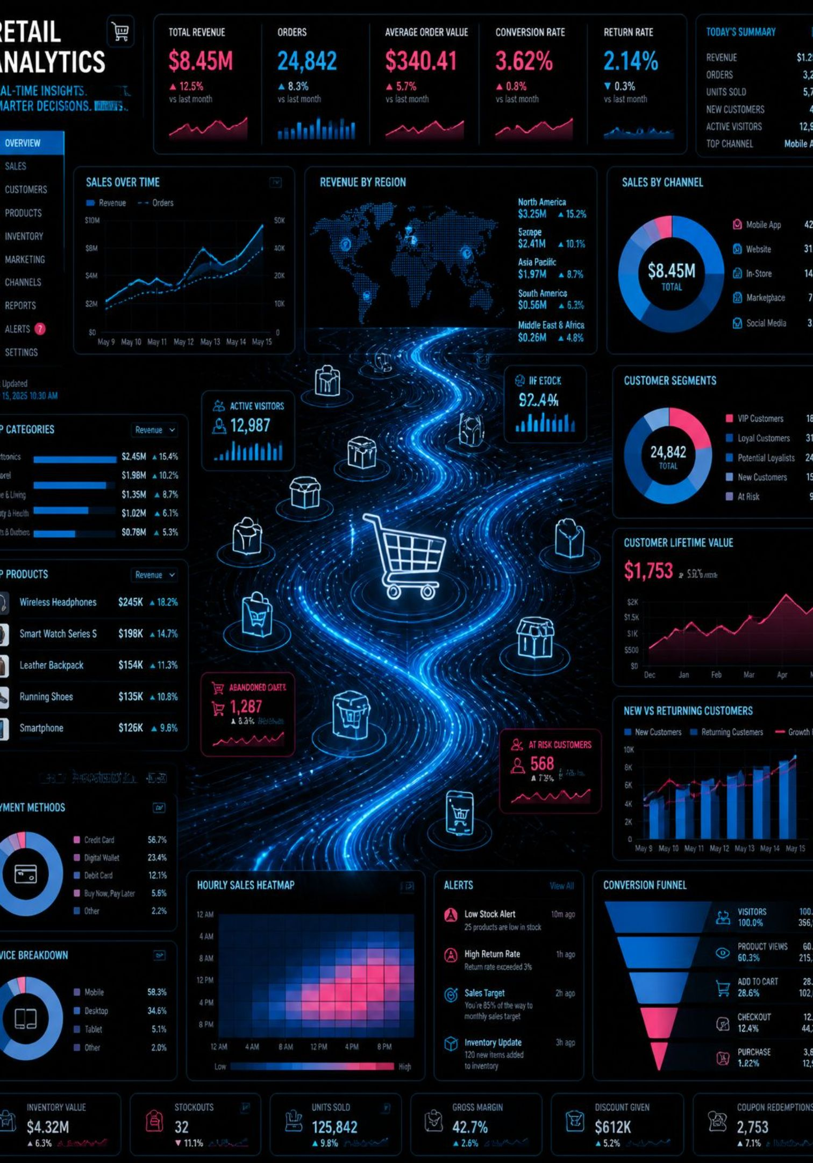
Customer Shopping Behavior Analysis
Data Analytics Project
An end-to-end analysis of retail purchase behavior using Python, SQL, and Power BI — uncovering spending patterns, customer segments, and strategic opportunities across 3,900 transactions.
PYTHON
SQL
POWER BI
3,900 TRANSACTIONS

Slide 2



Dataset & Project Overview
Transactional retail data spanning 3,900 rows and 18 columns — demographics, purchase details, and shopping behavior — with 37 missing Review Rating values imputed by category median.
Objective
Business Problem
Expected Outcome
Analyze spending patterns, segments, product preferences, and subscription behavior
Identify which segments and products drive revenue and how discounts affect behavior
Actionable recommendations on subscriptions, loyalty, discounting, and targeted marketing

Slide 3
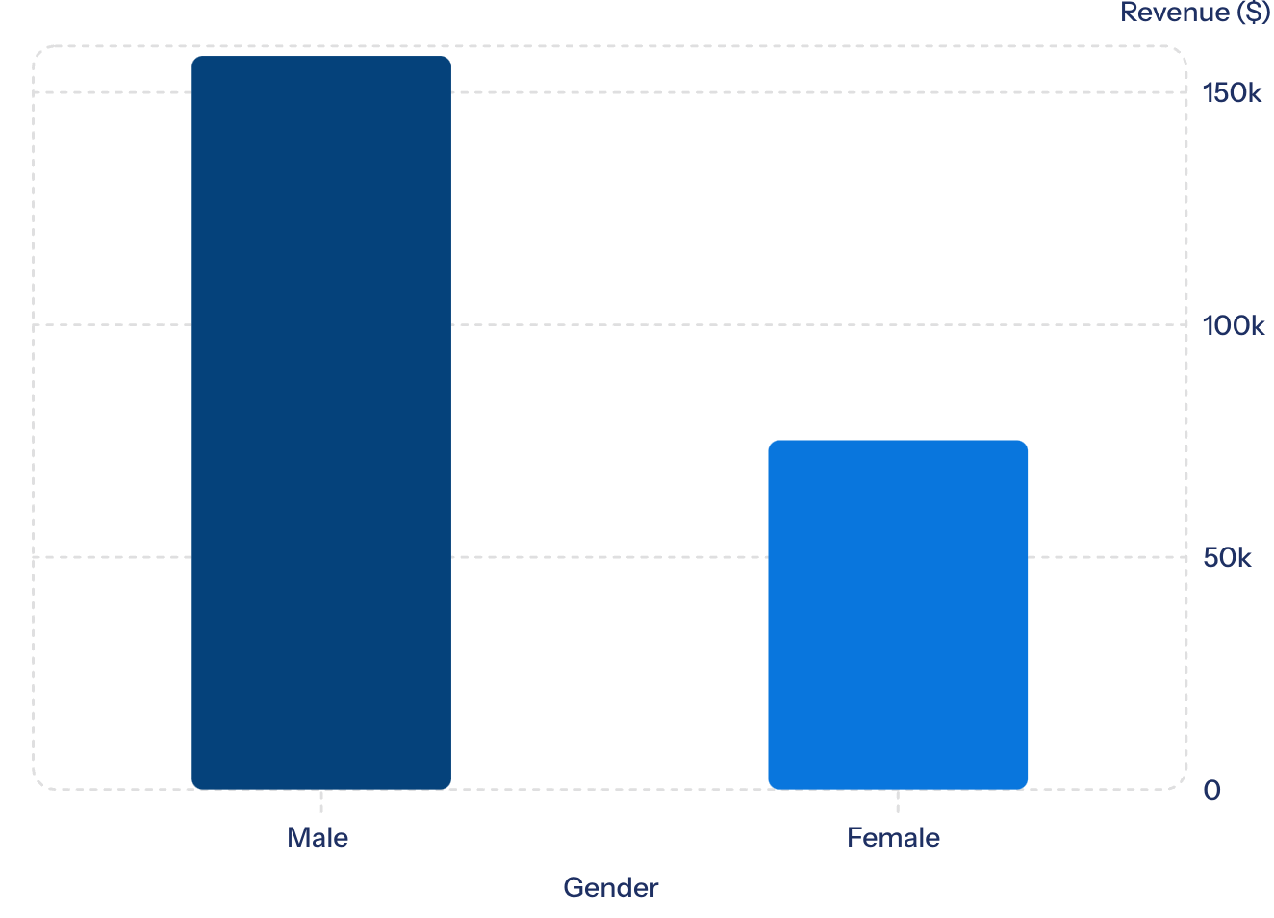

Key Findings from SQL Analysis
Revenue by Gender
Male customers generated over 2× the revenue of female customers — a significant behavioral gap warranting targeted outreach.
Subscribers vs. Non-Subscribers
Customer Segments
Revenue by Age Group
Non-subscribers drive $170,436 in revenue (2,847 customers) vs. subscribers' $62,645 (1,053 customers), despite similar average spend.
Loyal: 3,116 | Returning: 701 | New: 83. Repeat buyers: 958 subscribed vs. 2,518 non-subscribed.
Young Adult leads at $62,143, followed by Middle-aged ($59,197), Adult ($55,978), and Senior ($55,763).

Slide 4
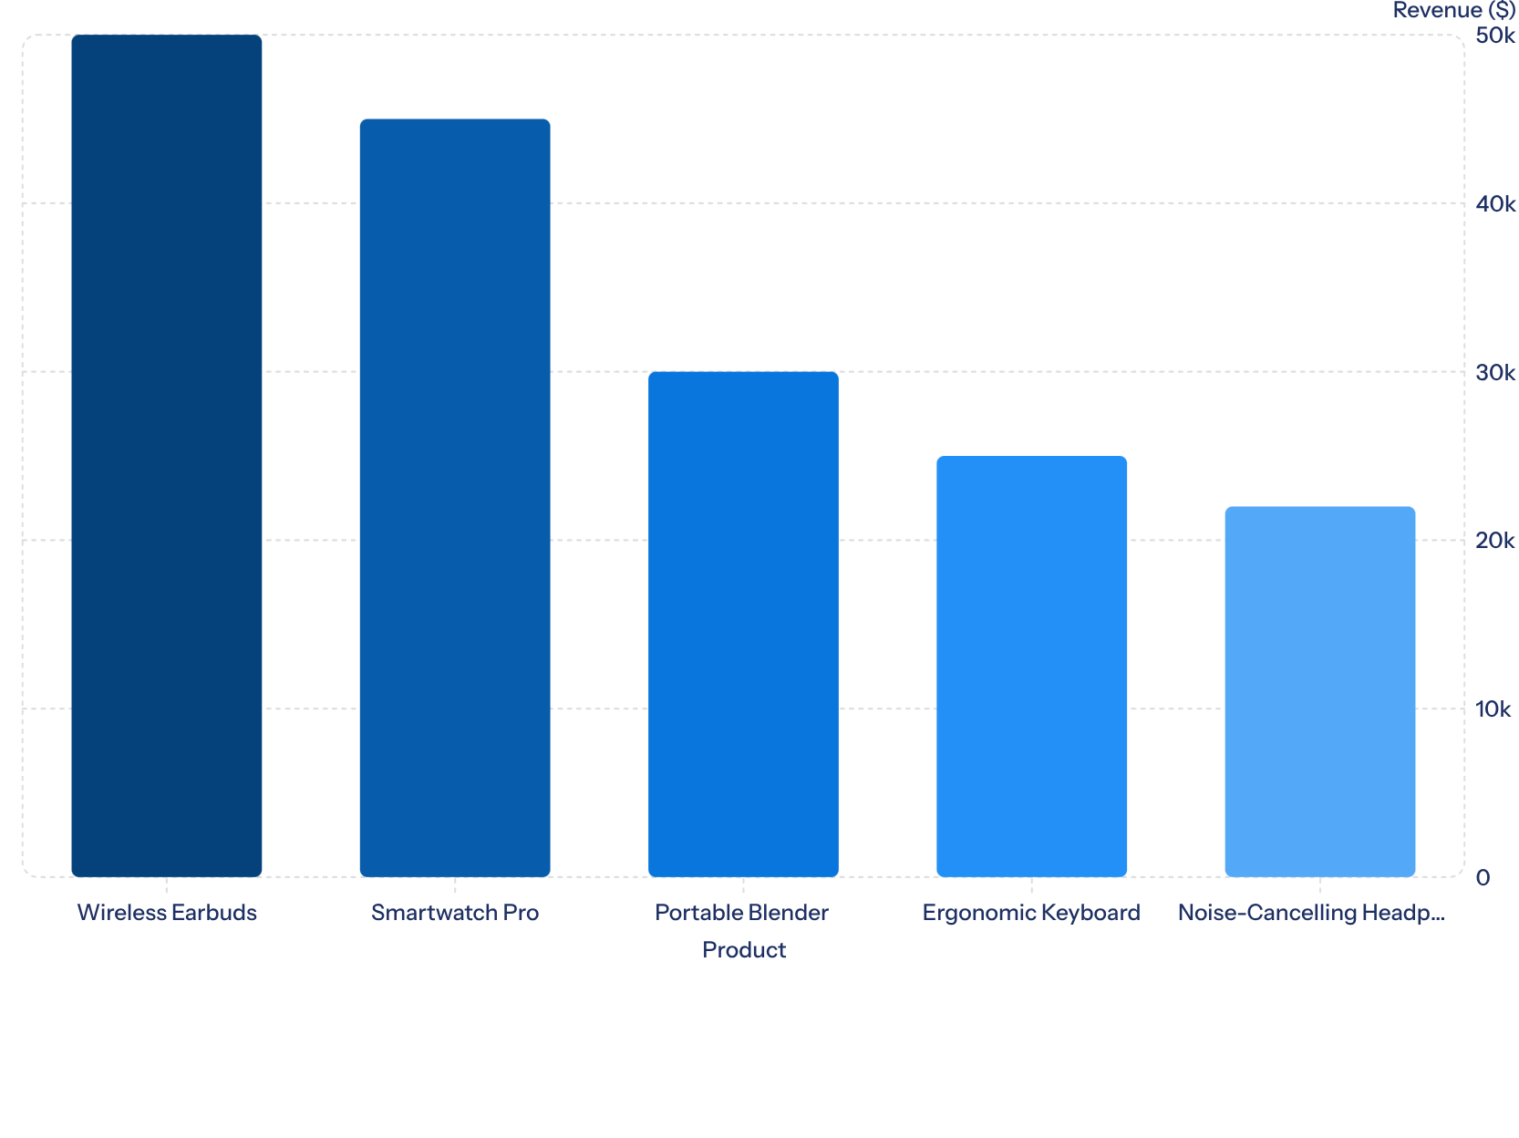

Product Performance & Customer Preferences
Understanding which products resonate most with customers, their perceived value, and how often they are purchased provides critical insights for inventory, marketing, and product development strategies.
Ratings Impact
Products with an average rating of 4.5 stars or higher demonstrate a 30% increase in repeat purchases.
Purchase Frequency
High-demand consumables show a 2x higher weekly purchase frequency compared to durable goods.
Category Insights
The Electronics category drives the highest average transaction value, while Home Goods leads in repeat buys.
The column chart highlights our top 5 revenue-generating products, with Wireless Earbuds leading significantly. This data informs promotional focus and stock management.

Slide 5





Business Recommendations & Skills
Boost Subscriptions
Loyalty Programs
Review Discount Policy
Promote exclusive subscriber benefits to convert high-value non-subscribers
Reward repeat buyers to grow the Loyal segment
Balance sales lift with margin control, especially for discount-dependent products
Product Positioning
Targeted Marketing
Highlight top-rated products — Gloves, Sandals, Boots — in campaigns
Focus on Young Adults and express-shipping users for highest ROI
Skills Demonstrated
PYTHON
PANDAS
NUMPY
SQL
MYSQL
POWER BI
DATA CLEANING
EDA
DATA VISUALIZATION
BUSINESS ANALYTICS
FEATURE ENGINEERING

Slide 6

Customer Segmentation Deep Dive
Understanding distinct customer groups is crucial for tailored strategies. We categorized our customer base into three segments: New, Returning, and Loyal, each with unique behaviors and retention challenges.
1
2
3
NEW CUSTOMERS
RETURNING CUSTOMERS
LOYAL CUSTOMERS
83 Customers
701 Customers
3,116 Customers
These are first-time purchasers. Our focus is on providing an excellent initial experience to encourage repeat purchases and move them into the Returning segment.
Customers who have made at least two purchases. This group shows early signs of engagement and represents a significant opportunity for cultivating loyalty.
Our most valuable customers, characterized by consistent purchases and high engagement. They are vital for long-term revenue and brand advocacy.
Key metric: Purchase Frequency, Average Order Value (AOV)
Strategy: Loyalty programs, personalized recommendations, exclusive content
Key metric: Customer Lifetime Value (CLV), Churn Rate
Strategy: VIP treatment, early access to products, referral incentives
Key metric: First Purchase to Second Purchase Conversion Rate
Strategy: Onboarding sequences, welcome offers, feedback requests
By understanding the unique needs and behaviors of each segment, we can develop targeted marketing and retention strategies to maximize customer lifetime value.

Slide 7
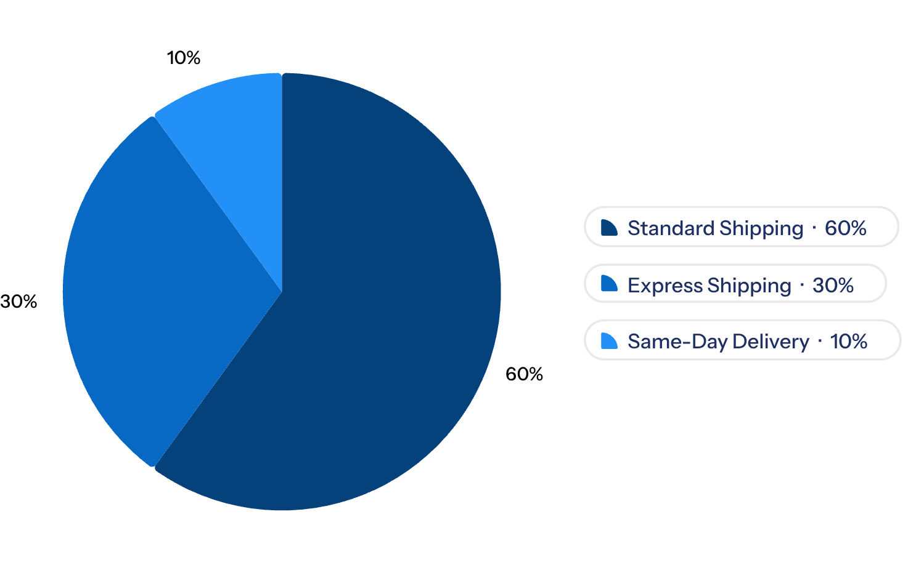
Discount Strategies & Shipping Trends
Discount Impact on Purchase Behavior
Customer Shipping Preferences
Analysis indicates that while promotional discounts successfully increase purchase frequency by 15%, they concurrently lead to a 7% reduction in average transaction value. This suggests discounts attract more price-sensitive buyers or encourage smaller, more frequent purchases rather than larger basket sizes.
Strategic use of discounts should target specific product categories or customer segments to maximize net revenue, rather than broad-stroke promotions.
60% of customers prefer Standard Shipping, showing a strong preference for lower-cost delivery.
Meanwhile, 30% choose Express and 10% opt for Same-Day Delivery, indicating demand for faster shipping options.

Slide 8
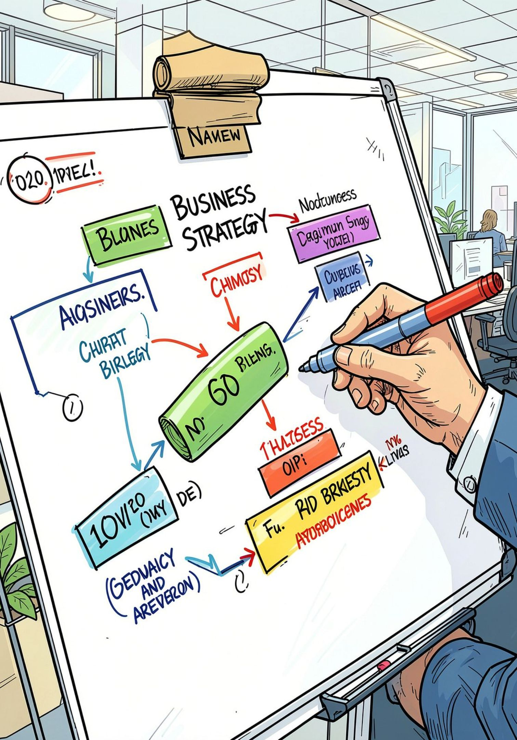
Conclusion & Next Steps
Our analysis reveals critical insights into customer behavior and product performance, providing a clear roadmap for strategic growth and enhanced profitability.
Key Takeaways
Actionable Next Steps
Male customers contribute 2x more revenue, indicating a need for gender-specific strategies.Male customers generate 2× more revenue.
Non-subscribers present a strong conversion opportunity.
Top-rated, high-demand products drive repeat sales.
Optimize discounts to balance sales and profitability.
Customer segmentation enables targeted marketing.
A large non-subscriber base represents a significant conversion opportunity for subscription growth.
High-rated products and high-demand consumables are key drivers of repeat purchases and revenue.
Discounting increases purchase frequency but reduces average transaction value, requiring careful optimization.
Customer segmentation into New, Returning, and Loyal groups allows for tailored engagement strategies.
Convert high-value non-subscribers to paid subscriptions.
Convert high-value non-subscribers into paid subscribers.
Strengthen loyalty programs for returning and loyal customers.
Optimize discount strategies to boost profit and sales.
Implement gender-specific marketing campaigns.
Promote top-rated products and optimize inventory for high-demand items.

